Slide 1
\LaTeX
For Scientific Documentation
By Ammar Taha Mohamedy
Page Layout

Slide 2
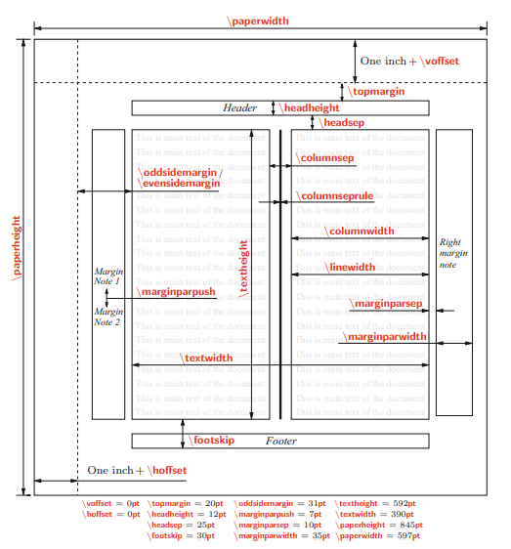
Figure 5.1, LaTeX in 24 hours, Datta, Springer

Slide 3
Adjusting Page Layout Commands
Explicit Definition: \command = value
Set Length: \setlength{\command}{value}

Slide 4
Single Page Enlarging
\enlargethispage{}
\enlargethispage*{}

Slide 5
Page Style: Header and Footer
\pagestyle{}
\thispagestyle{}
1) empty: Empty header and footer, and no page numbering.
2) plain: Empty header, but the footer contains the numbering at the center.
3) headings: Empty footer, but the header contains page numbering and title.
4) myheadings: Same as headings, but the title is user costumed.
5) fancy: User-Customed header and footer under the fancyheadings, and fancyhdr Packages.

Slide 6
Thanks for Watching !!

